Slide 1
Movie Data Science Case Study
Arpit Khandekar
akhandekar@hawk.iit.edu
+1 3128010666

Slide 2
Introduction
What is Movie Data Science Case Study?
In this case study we have provided movie_metadata which contains 5000 approx records and the objective is to get insight knowledge of the raw data provided to us.
Important factors of the Case study?
gross, budget, movie_score, movie_facebook_likes, language, country

Slide 3
Data Pre-Processing
Data Cleaning: To find null values
->df.isnull().sum()
df.shape
We can find 5043 columns and 28 rows in our datasets.
df["budget"].fillna("39752620.44", inplace = True)
Replacing null values using the mean value for the budget data.
Performing minmax normalization technique and defining variables within range of 0 to 100.
minmax=preprocessing.MinMaxScaler(feature_range=(0,100))
from sklearn import preprocessing
minmax=preprocessing.MinMaxScaler(feature_range=(0,100))
minmax.fit([df['gross']]).transform([df['gross']])

Slide 4
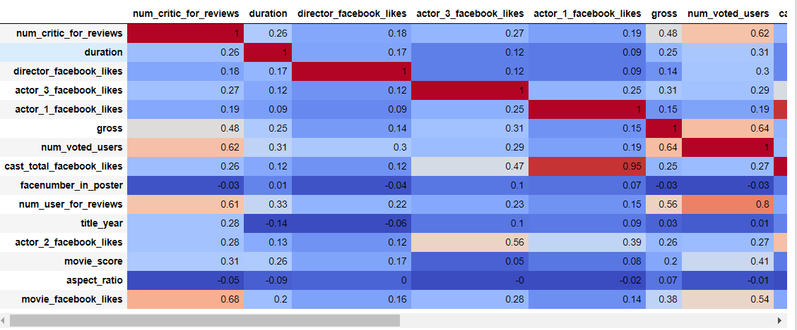
Data Exploratory Analysis
With the help of correlation matrix we can found that what are the features which are affecting the Movie Gross income, we found that num_voted_users and num_user_for_reviews having correlation values as 0.64 and 0.56 respectively, which are the highest values with Gross our target feature. We will be using those two feature to build a linear regression model.

Slide 5
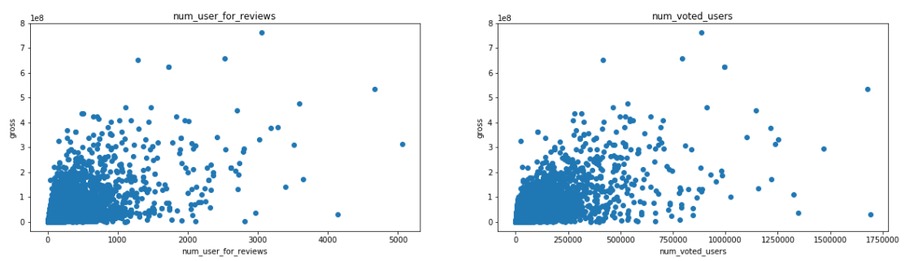
Data Pre-Processing
We found that the features which are affecting the Movie Gross income are num_voted_users and num_user_for_reviews We will be using scatter plot let’s see how these features vary with Gross.
We found that there are some outliers in both the relations. Also, in the both the graph we can observe that as the number of voted users and number users for reviews for reviews increases gross amount increase, hence there is linear relationship among those features.

Slide 6
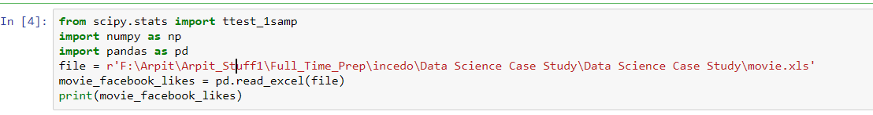
Hypothesis Testing
In this case our null hypothesis testing is Movie having Facebook likes average of equal to 5000 is considered as blockbuster movie?
Our alternative hypothesis testing would be opposite to null hypothesis testing which states that average Facebook likes not equal to 5000 is not considered as blockbuster movie.
We imported libraries and read the file in python.

Slide 7

Hypothesis Testing
In One sample t-test : The One Sample t Test determines whether the sample mean is statistically different from a known or hypothesised population mean. The One Sample t Test is a parametric test.
We are taking confidence interval as 95% for our hypothesis testing.
Hence if pval is less than 0.05 then we are rejecting null hypothesis otherwise we will accept it.

Slide 8
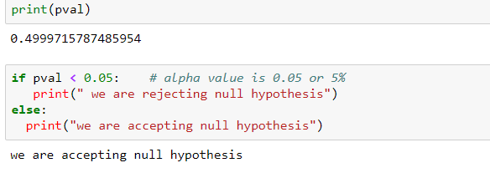
Hypothesis Testing
In our hypothesis testing we are accepting the null hypothesis which say’s that if movies are having an average of 5000 Facebook likes will be considered as Blockbuster movie.

Slide 9
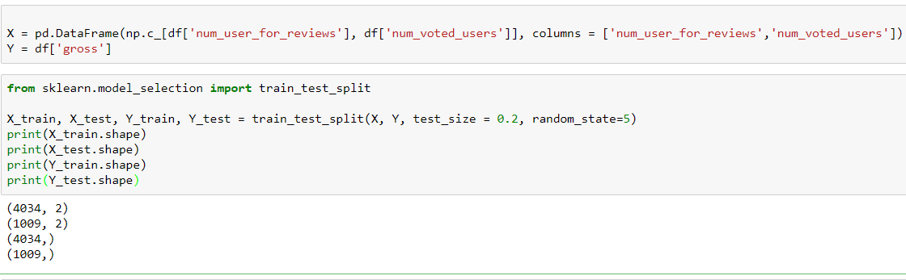
Preparing the model Training and Testing
Next, we split the data into training and testing sets. We train the model with 80% of the samples and test with the remaining 20%.
We do this to assess the model’s performance on unseen data. To split the data we use train_test_split function provided by scikit-learn library

Slide 10
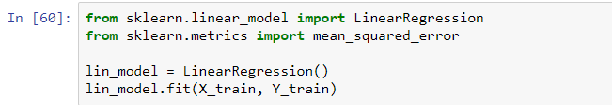
Defining model
We have defined the linear regression model having Gross feature as dependent variable and num_voted_users and num_user_for_reviews as our independent variable. Hence this model helps in identifying at scale the movie is considered blockbusters.

Slide 11
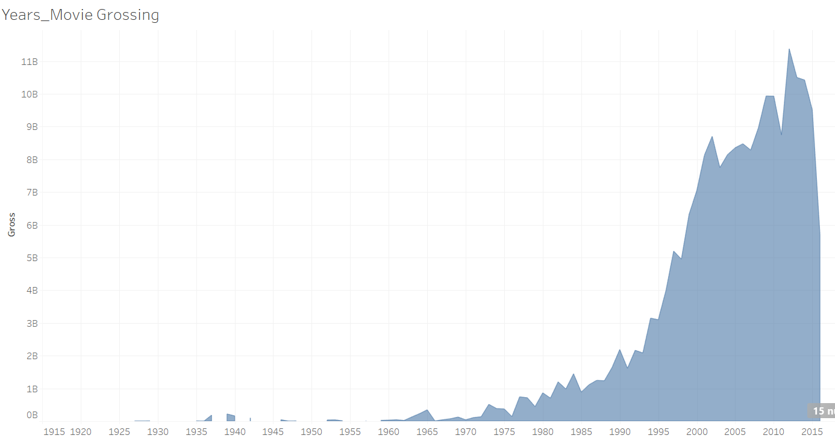
Movies total gross amount by year
Movies total gross amount by year
It is clearly seen from the graph that in the year 2012 movies has most grossing.
Year 2012 was the best year for directors in terms of grossing.

Slide 12

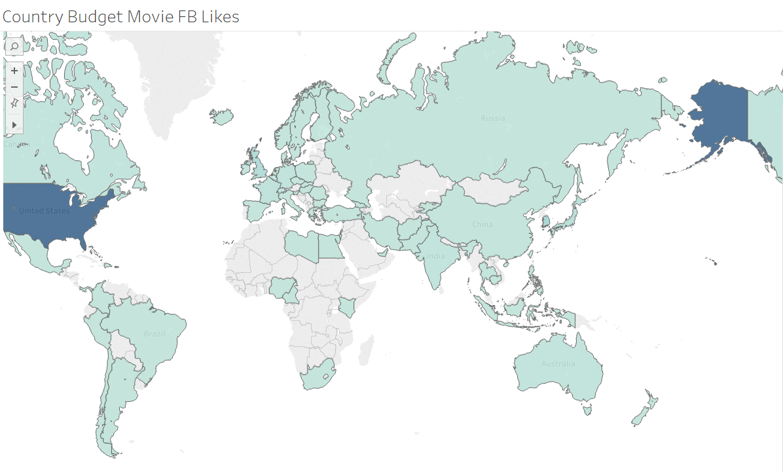
Country’s Movie Budget vs FB Likes
Figure shows Number of FB likes made in different countries and its Budget.

Slide 13
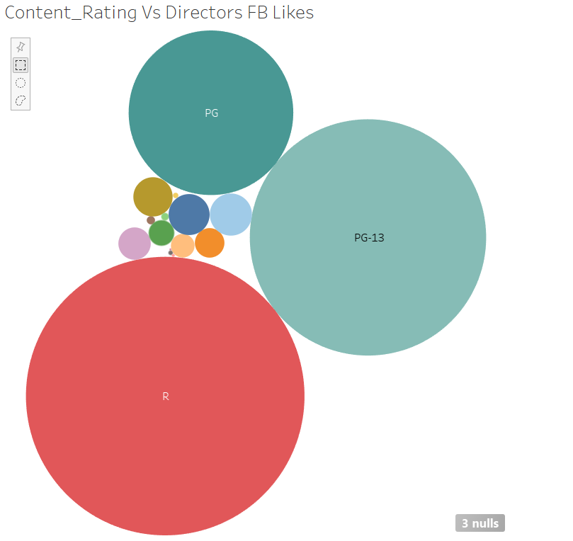
Content Rating Vs Director FB Likes
Figure shows director FB likes based on the Content rating for the movies.

Slide 14
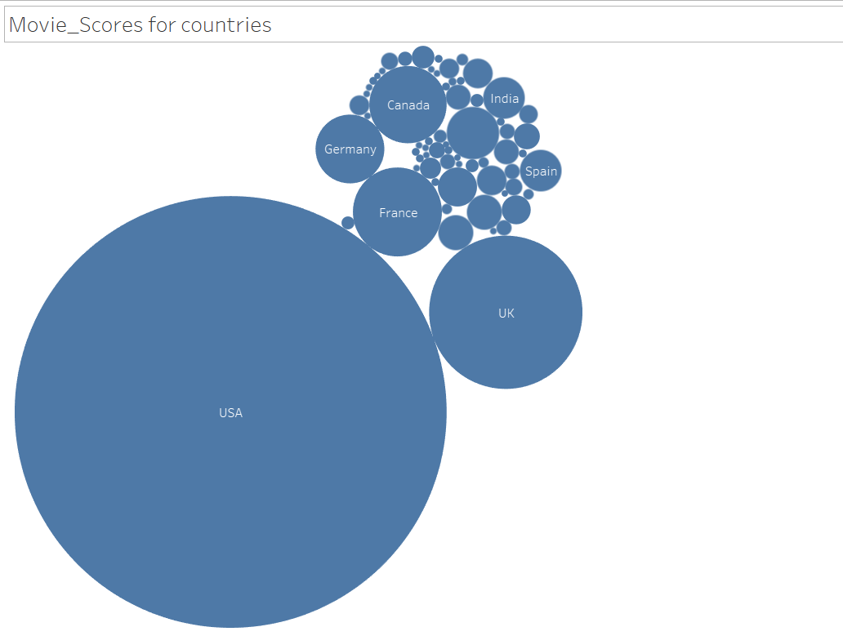
Movie scores Vs Content Rating
Figure shows Movies score based on the different countries.

Slide 15
Movie_data_Interactive Dashboard
https://public.tableau.com/profile/arpit.khandekar#!/vizhome/Movie_Data_Analysis_15572018094310/Movie_dashboard?publish=yes

Slide 16
Thank You!

